Slide 1
MKTG 571:
Balancing Acquisition & Retention Efforts
Optimal Resource Allocation

Slide 2
Today’s Agenda
To discuss why it is important to balance resources between acquisition and retention
To illustrate how firms can allocate resources effectively between acquisition and retention efforts to maximize profitability
To discuss the CRM initiatives at Hilton Hotels

Slide 3
Acquisition (Recap)
What is the relationship between acquisition spending and acquisition rate?
What is the benefit of a higher acquisition rate?
How do you do acquisition effectively?

Slide 4
Retention (Recap)
What is the relationship between retention spending and retention rate?
What is the benefit of a higher retention rate?
How do you do retention effectively?

Slide 5
Customer Flow
Profit
Acquisition Rate
Customer Base
Churn Rate

Slide 6
Balancing Acquisition and Retention
Given a limited budget there is a need to optimally allocate resources between acquisition efforts and retention efforts
How do we do this?
What are the consequences of getting it wrong?

Slide 7
Problem Setup
Getting the Most out of All Your Customers:
  Where are companies going wrong?
    Maximize Acquisition Rate, Retention Rate??
  Where do the profits come from?
    Low/High Acquisition/Retention Costs

Slide 8
Does Cost Drive Profit?
High Maintenance Customers 25% of Customers 15% of Profits | Royal Customers 28% of Customers 25% of Profits
Casual Customers 32% of Customers 20% of Profits | Low-maintenance Customers 15% of Customers 40% of Profits
High
Retention Cost
Low
Low
High
Acquisition Cost

Slide 9
The Modeling Framework
Three Models:
  Acquisition Likelihood
  Relationship Duration
  Profitability

Slide 10
The Modeling Framework
Acquisition
Retention
Acquired
Customers
Current Customers
Profitability
Prospects
Non-Acquired
Customers
Relationship Duration
Resource Allocation

Slide 11
Results
Company | Spending Change | Profit Change
B2B | -68.30% | +41.52%
Pharmaceutical | +31.40% | +35.80%
Catalog Retailer | -30.70% | +28.90%
Should you spend more to get more or spend less to get more?

Slide 12
A Hands-on Example
Text and Excel File are available in Canvas
Problem Setup:
  We want to understand the drivers of Acquisition, Relationship Duration, and Profitability at a firm using a random sample of 500 prospects/customers
  We will use the modeling framework discussed earlier on these slides

Slide 13
Modeling Framework
We will take a 4-step approach:
  Estimate Acquisition Model
  Estimate Relationship Duration Model
  Estimate Profitability Model
  Simulate Optimal Resource Allocation Scenarios
  (We also need to account for the correlation across models)

Slide 14
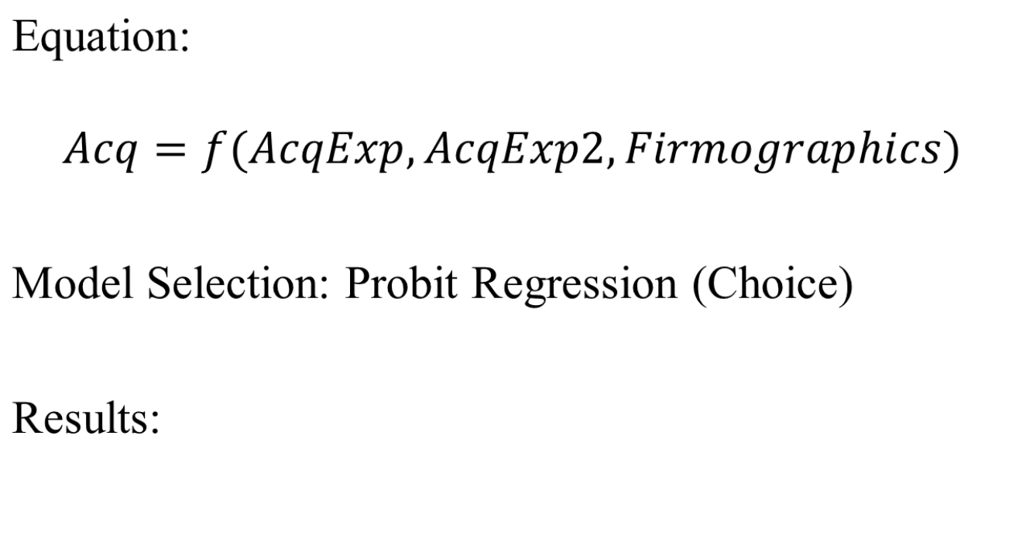
Acquisition Model
Variable | Estimate | Standard Error | p-value
Intercept | -8.255 | 0.811 | < 0.0001
Acq_Exp | 0.017 | 0.002 | < 0.0001
Acq_Exp_SQ | -0.00002 | 0.000002 | < 0.0001
Industry | 1.217 | 0.168 | < 0.0001
Revenue | 0.043 | 0.008 | < 0.0001
Employees | 0.004 | 0.0004 | < 0.0001

Slide 15
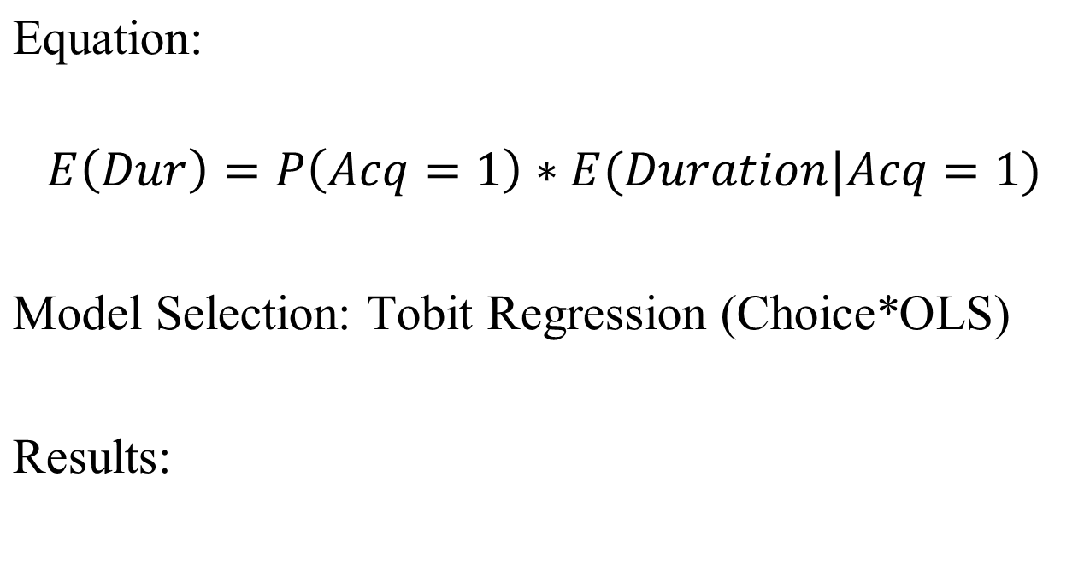
Duration Model
Variable | Estimate | Standard Error | p-value
Intercept | 91.008 | 9.756 | < 0.0001
Ret_Exp | 2.528 | 0.029 | < 0.0001
Ret_Exp_SQ | -0.001 | 0.00002 | < 0.0001
Freq | 7.072 | 0.806 | < 0.0001
Freq_SQ | -0.842 | 0.040 | < 0.0001
Crossbuy | 3.196 | 0.479 | < 0.0001
SOW | 0.353 | 0.045 | < 0.0001
λ | 29.520 | 2.557 | < 0.0001

Slide 16
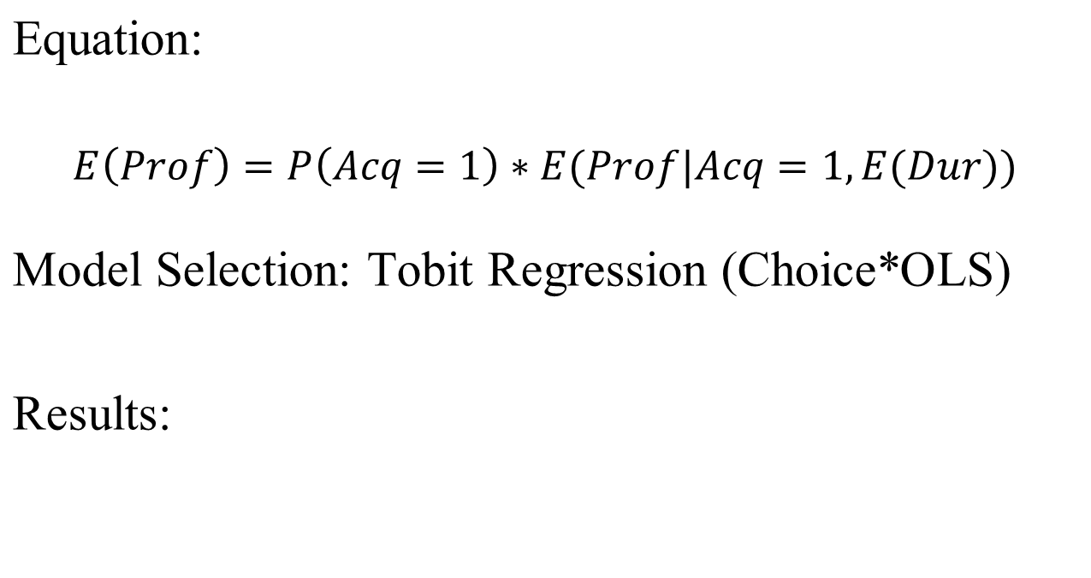
Profitability Model
Variable | Estimate | Standard Error | p-value
Intercept | 7.038 | 48.899 | 0.8856
Acq_Exp | 3.344 | 0.132 | < 0.0001
Acq_Exp_SQ | -0.001 | 0.0001 | < 0.0001
Ret_Exp | 3.846 | 0.185 | < 0.0001
Ret_Exp_SQ | -0.001 | 0.0001 | < 0.0001
Freq | 17.820 | 2.751 | < 0.0001
Freq_SQ | -1.349 | 0.144 | < 0.0001
Crossbuy | 18.189 | 1.636 | < 0.0001
SOW | 2.075 | 0.158 | < 0.0001
λ | 107.586 | 44.839 | 0.0170
Durâtion | 0.496 | 0.066 | < 0.0001

Slide 17
Resource Allocation
We now know the drivers of the three models
How do changes in acquisition expenses and retention expenses affect acquisition rates, duration lengths, and total profitability?
Let’s test 4 scenarios and compare them to the current profitability

Slide 18
Resource Allocation
Scenarios:
  Maximize the acquisition rate across all customers given the current marketing budget
  Maximize the average duration across all customers given the current marketing budget
  Maximize the total profit across all customers given the current marketing budget
  Maximize the total profit across all customers given no budget limitation

Slide 19
Results
 | E(Profit) | E(Duration) | E(Acq. %) | Acq_Exp | Ret_Exp | Total Exp
Current | $1,186,533.65 | 1098.30 | 67.60% | $493.35 | $497.43 | $414,806.49
E(Acq. %) | $1,461,084.20 | 820.65 | 77.18% | $432.50 | $514.52 | $414,806.49
E(Duration) | $1,467,513.08 | 999.75 | 69.13% | $321.75 | $734.65 | $414,806.49
E(Profit) | $1,491,985.70 | 974.59 | 74.88% | $371.69 | $611.50 | $414,806.49
E(Profit) w/ no limits | $2,732,723.87 | 470.46 | 76.95% | $451.88 | $2,273.72 | $1,100,788.28
What happens when we maximize:
  Acquisition Rate?
  Expected Duration?
  Profit?
  Profit without a budget constraint?

Slide 20
Hilton Hotels: CRM
What is Hilton’s core business?
What is the value of a brand in the lodging industry?
Evaluate the CRM initiative.
  Efficiencies at the Call Center
  Property-level effects
What should Hilton do next?

Slide 21
Optional Workshops
Getting your hands dirty with data using SAS
Dates and Times:
TBD based on interest

Slide 22
For Next Class
Topic:
  Customer Profitability: RFM and PCV
Reading:
  Recency, Frequency, and Monetary (RFM) Analysis (download)
Assignment:
  None

